Slide 1
Structured Query Language
RDBMS
DDL
DML
DCL
TCL

Slide 2
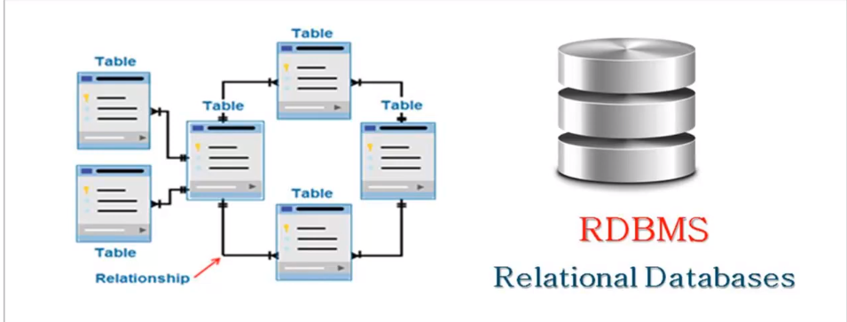
RDBMS
A program that allows us to create, delete and update a relational DB
A database system that stores and retrieves data in a structured format organized in the form of rows and columns
“Relational" because the values within each table are related to each other

Slide 3
Data Definition Language
CREATE : creates a new table
Syntax: CREATE DATABASE database_name;
Ex: CREATE TABLE Employee
(
EmployeeID int,
FirstName varchar(255),
LastName varchar(255),
Email varchar(255),
AddressLine varchar(255),
City varchar(255)
);

Slide 4
ALTER : adds, modifies or deletes columns in an existing table, used to rename a table, adds and drops various constraints on an existing table
Ex: alter table info
add Mobile int NOT NULL
after City;
OR
alter table info
add Address varchar(255) NOT NULL;

Slide 5
DROP : used to delete or remove indexes from a table and delete or drop an existing database in a SQL schema
Syntax: DROP DATABASE database_name;
DROP TABLE table_name;
RENAME : used to change the name of a table
Syntax: ALTER TABLE table_name
RENAME TO new_table_name;
TRUNCATE : used to delete all the rows from the table and free the containing space
Syntax: TRUNCATE TABLE employee;

Slide 6
Data Manipulation Language
SELECT : extracts data from a table/database
Syntax: SELECT expressions
FROM tables
WHERE conditions;
Ex: SELECT * FROM EMPLOYEES;
INSERT : inserts new data into a table/database
Syntax: INSERT INTO table_name
VALUES (value1, value2, value3....);
Ex: INSERT INTO STUDENTS (ROLL_NO, NAME, AGE, CITY)
VALUES (1, ‘ABHIRAM’, 22, ‘ALLAHABAD’);

Slide 7
UPDATE : used to change the data of the records held by tables. The rows that need to be updated are decided by a condition. To specify the condition, we use WHERE clause
Syntax:
UPDATE table_name
SET column_name = expression
WHERE conditions
Ex: update info set Lastname=xyz where EmployeeID= '2';
DELETE : used to delete data from table/database
Syntax: DELETE FROM table_name [WHERE condition];
Ex: DELETE from employees where emp_id=1;

Slide 8
Operator | Description | Example
= | Equal | Try it
> | Greater than | Try it
< | Less than | Try it
>= | Greater than or equal | Try it
<= | Less than or equal | Try it
<> | Not equal. Note: In some versions of SQL this operator may be written as != | Try it
BETWEEN | Between a certain range | Try it
LIKE | Search for a pattern | Try it
IN | To specify multiple possible values for a column | Try it

Slide 9
SELECT * FROM Products
WHERE Price = 18;
SELECT * FROM Products
WHERE Price > 30;
SELECT * FROM Products
WHERE Price <= 30;
SELECT * FROM Products
WHERE Price BETWEEN 50 AND 60;
SELECT * FROM Customers
WHERE City LIKE 's%';

Slide 10
The SQL AND, OR and NOT Operators
The WHERE clause can be combined with AND, OR, and NOT operators.
The AND and OR operators are used to filter records based on more than one condition:
The AND operator displays a record if all the conditions separated by AND are TRUE.
The OR operator displays a record if any of the conditions separated by OR is TRUE.

Slide 11
AND Syntax
SELECT column1, column2, ... FROM table_name WHERE condition1 AND condition2 AND condition3 ...;
Example
SELECT * FROM Customers WHERE Country='Germany' AND City='Berlin';
OR Syntax
SELECT column1, column2, ... FROM table_name WHERE condition1 OR condition2 OR condition3 ...;
Example
SELECT * FROM Customers WHERE City='Berlin' OR City='München';
NOT Syntax
SELECT column1, column2, ... FROM table_name WHERE NOT condition;
Example
SELECT * FROM Customers WHERE NOT Country='Germany';

Slide 12
Data Control Language- GRANT, REVOKE
Transaction Control Language- COMMIT, ROLLBACK, SAVEPOINT, SET TRANSACTION

Slide 13
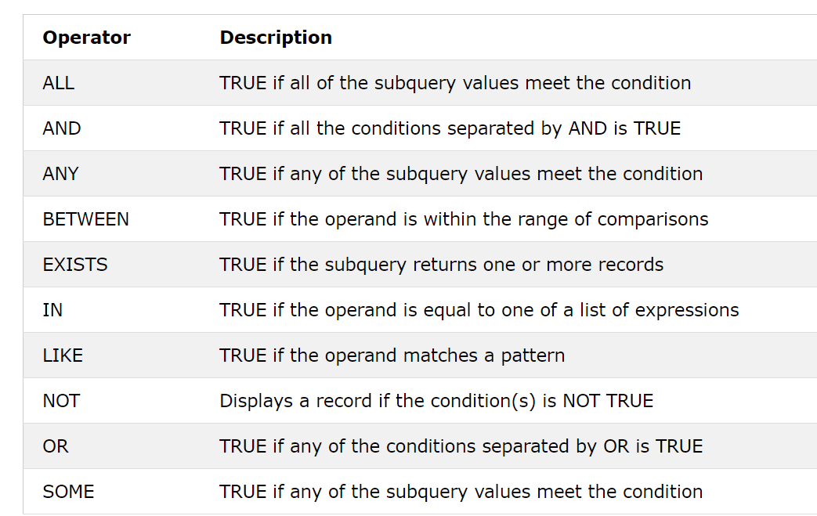
SQL Logical Operators:

Slide 14
The SQL ORDER BY Keyword The ORDER BY keyword is used to sort the result-set in ascending or descending order. The ORDER BY keyword sorts the records in ascending order by default. To sort the records in descending order, use the DESC keyword.
ORDER BY Syntax
SELECT column1, column2, ... FROM table_name ORDER BY column1, column2, ... ASC|DESC;
SELECT * FROM Customers ORDER BY Country;
SELECT * FROM Customers ORDER BY Country DESC;

Slide 15
What is a NULL Value? A field with a NULL value is a field with no value. If a field in a table is optional, it is possible to insert a new record or update a record without adding a value to this field. Then, the field will be saved with a NULL value.
IS NULL Syntax
SELECT column_names FROM table_name WHERE column_name IS NULL;
Example
SELECT CustomerName, ContactName, Address FROM Customers WHERE Address IS NULL;
IS NOT NULL Syntax
SELECT column_names FROM table_name WHERE column_name IS NOT NULL;
Example
SELECT CustomerName, ContactName, Address FROM Customers WHERE Address IS NOT NULL;

Slide 16
The SQL SELECT TOP Clause The SELECT TOP clause is used to specify the number of records to return. The SELECT TOP clause is useful on large tables with thousands of records. Returning a large number of records can impact performance.
SELECT TOP number|percent column_name(s) FROM table_name WHERE condition;
SELECT TOP 3 * FROM Customers;
The SQL LIKE Operator
The LIKE operator is used in a WHERE clause to search for a specified pattern in a column.
There are two wildcards often used in conjunction with the LIKE operator:
The percent sign (%) represents zero, one, or multiple characters
The underscore sign (_) represents one, single character

Slide 17
SQL Wildcard Characters
A wildcard character is used to substitute one or more characters in a string.
Wildcard characters are used with the LIKE operator. The LIKE operator is used in a WHERE clause to search for a specified pattern in a column.
Wildcard Characters in SQL Server
All the wildcards can also be used in combinations!
Here are some examples showing different LIKE operators with '%' and '_' wildcards:
Symbol | Description | Example
* | Represents zero or more characters | bl* finds bl, black, blue, and blob
? | Represents a single character | h?t finds hot, hat, and hit
[] | Represents any single character within the brackets | h[oa]t finds hot and hat, but not hit
! | Represents any character not in the brackets | h[!oa]t finds hit, but not hot and hat
- | Represents any single character within the specified range | c[a-b]t finds cat and cbt
# | Represents any single numeric character | 2#5 finds 205, 215, 225, 235, 245, 255, 265, 275, 285, and 295
Symbol | Description | Example
% | Represents zero or more characters | bl% finds bl, black, blue, and blob
_ | Represents a single character | h_t finds hot, hat, and hit
[] | Represents any single character within the brackets | h[oa]t finds hot and hat, but not hit
^ | Represents any character not in the brackets | h[^oa]t finds hit, but not hot and hat
- | Represents any single character within the specified range | c[a-b]t finds cat and cbt
LIKE Operator | Description
WHERE CustomerName LIKE 'a%' | Finds any values that starts with "a"
WHERE CustomerName LIKE '%a' | Finds any values that ends with "a"
WHERE CustomerName LIKE '%or%' | Finds any values that have "or" in any position
WHERE CustomerName LIKE '_r%' | Finds any values that have "r" in the second position
WHERE CustomerName LIKE 'a__%' | Finds any values that starts with "a" and are at least 3 characters in length
WHERE ContactName LIKE 'a%o' | Finds any values that starts with "a" and ends with "o"

Slide 18
SQL Aliases SQL aliases are used to give a table, or a column in a table, a temporary name. Aliases are often used to make column names more readable. An alias only exists for the duration of that query. An alias is created with the AS keyword. Alias Column Syntax SELECT column_name AS alias_name FROM table_name; Alias Table Syntax SELECT column_name(s) FROM table_name AS alias_name;

Slide 19
Some more functions…
COUNT()- used to return the number of rows in a query
Ex: SELECT COUNT(*) FROM employee_table;
SELECT COUNT(ProductID) FROM Products;
AVG()- returns the average value of a numeric column
Ex: SELECT AVG(Price) FROM Products;
MIN()- returns the smallest value of the selected column
MAX()- returns the largest value of the selected column
LIKE- in a WHERE clause to search for a specified pattern in a column
Ex: SELECT * FROM Customers WHERE CustomerName LIKE 'a%';
ALIAS- to give a table, or a column in a table, a temporary name

Slide 20
Ex: SELECT CustomerID AS ID, CustomerName AS Customer FROM Customers;
TOP- used to select top data from a table
Ex: TOP 2 * FROM employee
Clauses continued…

Slide 21
Clauses
ORDER BY:
used for sorting data in ascending and descending order based on one or more columns (ascending order is default)
Syntax: SELECT column1, column2,... FROM table_name ORDER BY column1, column2, ... ASC|DESC;
Ex: SELECT * FROM Customers ORDER BY Country;
ORDER BY several columns:
Ex: SELECT * FROM Customers
ORDER BY Country ASC, CustomerName DESC;s

Slide 22
2. GROUP BY:
is used to arrange identical data into groups with the help of some functions. i.e if a particular column has same values in different rows then it will arrange these rows in a group
is used with aggregate functions (COUNT(), MAX(), MIN(), SUM(), AVG()) to group the result-set by one or more columns
is used with the SELECT statement
In the query, GROUP BY clause is placed after the WHERE clause
In the query, GROUP BY clause is placed before ORDER BY clause if used any

Slide 23
Syntax: SELECT column_name(s) FROM table_name WHERE condition GROUP BY column_name(s) ORDER BY column_name(s);
Ex: SELECT COUNT(CustomerID), Country FROM Customers GROUP BY Country;

Slide 24
HAVING:
is used to place conditions on groups
was added to SQL because the WHERE keyword cannot be used with aggregate functions
Syntax: SELECT column_name(s) FROM table_name WHERE condition GROUP BY column_name(s) HAVING condition ORDER BY column_name(s);
Ex: SELECT NAME, SUM(SALARY) FROM Employee GROUP BY NAMEHAVING SUM(SALARY)>3000;

Slide 25
4. WHERE:
specifies which rows to retrieve
returns only those queries which fulfill specific conditions used in SELECT, UPDATE, DELETE
Syntax: SELECT column1, column 2, ... column n
FROM table_name WHERE [conditions]

Slide 26
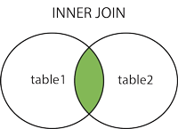
JOINS
is used to combine rows from two or more tables, based on a related column between them.
4 types of joins
(INNER) JOIN: Returns records that have matching values in both tables

Slide 27
Syntax: SELECT column_name(s) FROM table1 INNER JOIN table2 ON table1.column_name = table2.column_name;
Ex:
SELECT Orders.OrderID, Customers.CustomerName, Shippers.ShipperName FROM ((Orders INNER JOIN Customers ON Orders.CustomerID = Customers.CustomerID) INNER JOIN Shippers ON Orders.ShipperID = Shippers.ShipperID);

Slide 28
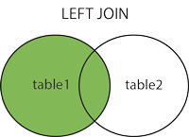
ii. LEFT (OUTER) JOIN: Returns all records from the left table, and the matched records from the right table
Syntax: SELECT column_name(s) FROM table1 LEFT JOIN table2 ON table1.column_name = table2.column_name;

Slide 29
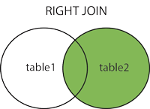
Ex: SELECT Customers.CustomerName, Orders.OrderID FROM Customers LEFT JOIN Orders ON Customers.CustomerID = Orders.CustomerID ORDER BY Customers.CustomerName;
iii. RIGHT (OUTER) JOIN: Returns all records from the right table, and the matched records from the left table

Slide 30
Syntax: SELECT column_name(s) FROM table1 RIGHT JOIN table2 ON table1.column_name = table2.column_name;
Ex: SELECT Orders.OrderID, Employees.LastName, Employees.FirstName FROM Orders RIGHT JOIN Employees ON Orders.EmployeeID = Employees.EmployeeID ORDER BY Orders.OrderID;

Slide 31
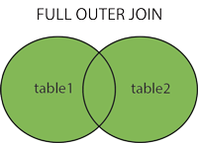
iv. FULL (OUTER) JOIN: Returns all records when there is a match in either left or right table
Ex: SELECT Customers.CustomerName, Orders.OrderID FROM Customers FULL OUTER JOIN Orders ON Customers.CustomerID=Orders.CustomerID ORDER BY Customers.CustomerName;

Slide 32
Common Terms
Primary Key: uniquely identifies each record in a table
must contain UNIQUE values and cannot contain NULL values
A table can have only ONE primary key; and in the table, this primary key can consist of single or multiple columns (fields)
Ex: CREATE TABLE Persons ( ID int NOT NULL, LastName varchar(255) NOT NULL, FirstName varchar(255), Age int, PRIMARY KEY (ID) );

Slide 33
Foreign Key:
is a field (or collection of fields) in one table that refers to the primary key in another table
The table with foreign key is called the child table and the table with the primary key is called the referenced or parent table
The FOREIGN KEY constraint prevents invalid data from being inserted into the foreign key column, because it has to be one of the values contained in the parent table
Ex: CREATE TABLE Orders ( OrderID int NOT NULL UNIQUE, OrderNumber int NOT NULL UNIQUE, PersonID int UNIQUE, PRIMARY KEY (OrderID), FOREIGN KEY (PersonID) REFERENCES Persons(PersonID) );

Slide 34
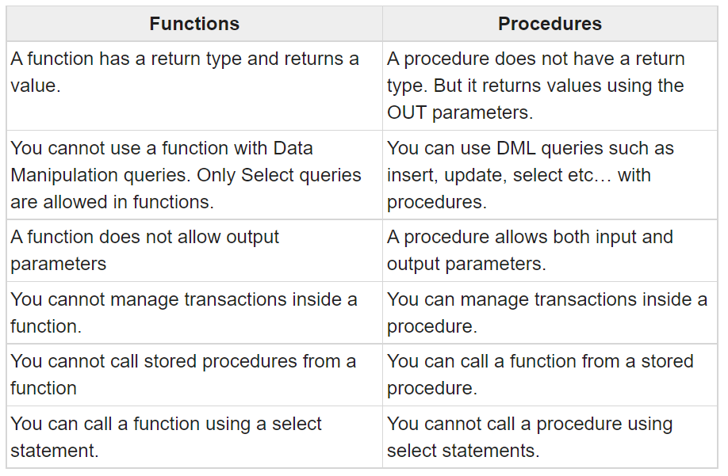

Slide 35
Ex of a Stored Procedure:
delimiter &&
create procedure mypro()
Begin
select * from customer;
select * from payments;
end &&
delimiter ;

